Slide 1
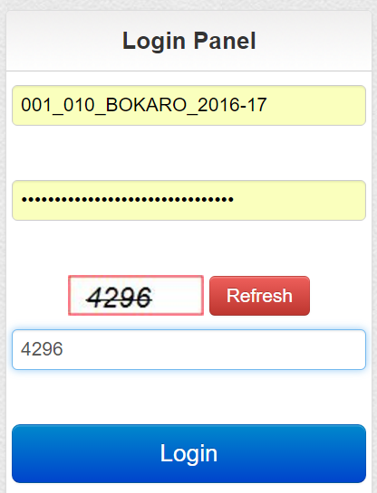
RETAILER LOGIN PAGE
ENTER THE LICENSE NUMBER
ENTER THE PASSWORD
ENTER CAPTCHA
CLICK ON LOGIN
Notes:
Retailer Login, Provide the License Number as User ID and Password with Valid Captcha.

Slide 2
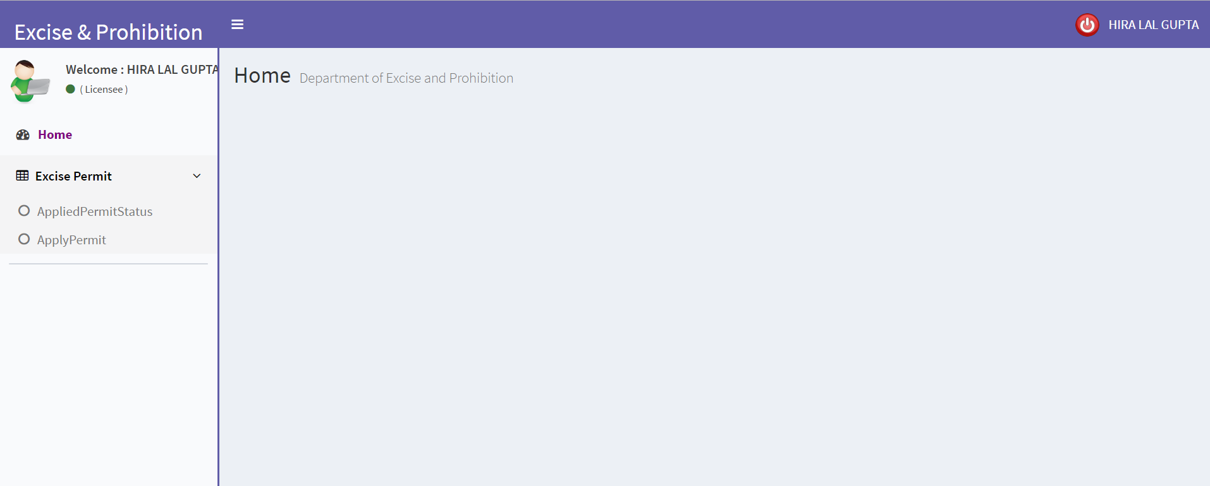
RETAILER DASHBOARD
LOGOUT
This is the menu for Applying for the Permit and Checking the Status of the permit as well.
Notes:
Retailer Dashboard with their respective Menus.

Slide 3
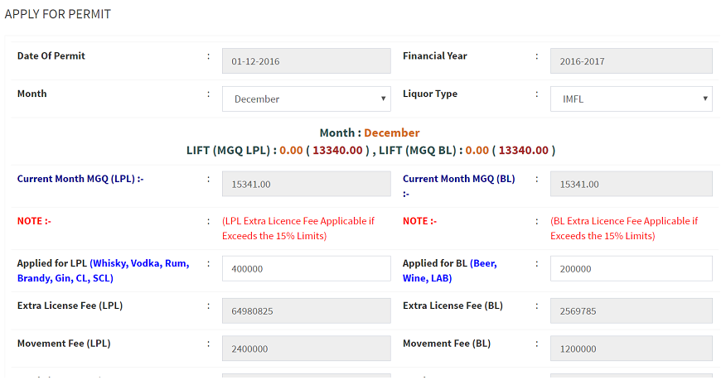
Apply for Permit (Phase 1)
Notes:
Apply for Permit (Half Form).

Slide 4
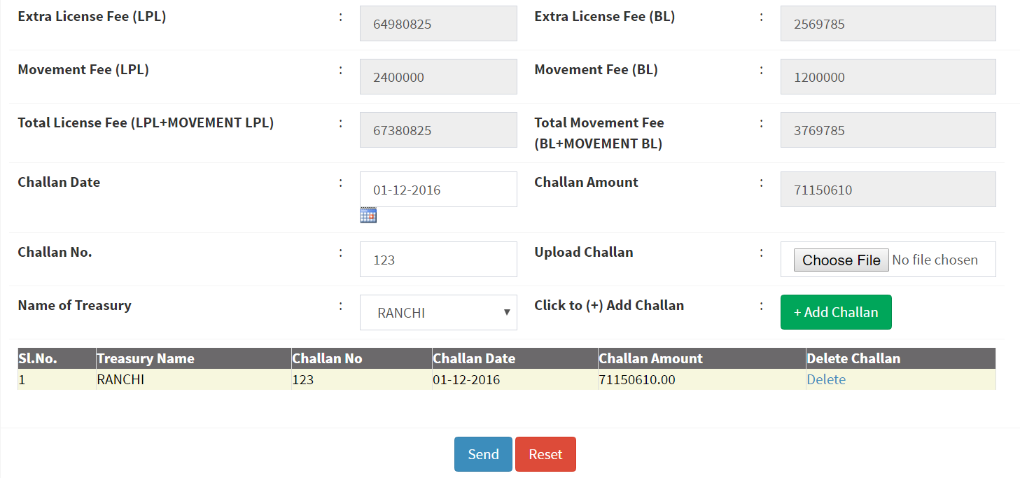
Apply for Permit (Phase 2)
Add Challan after submitting the values
Click for Applying the permit.
Notes:
Apply for Permit (Second Form) with Add / Delete Challans Facility.

Slide 5
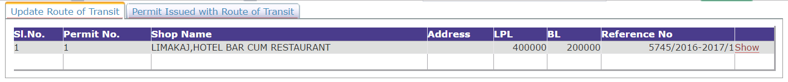
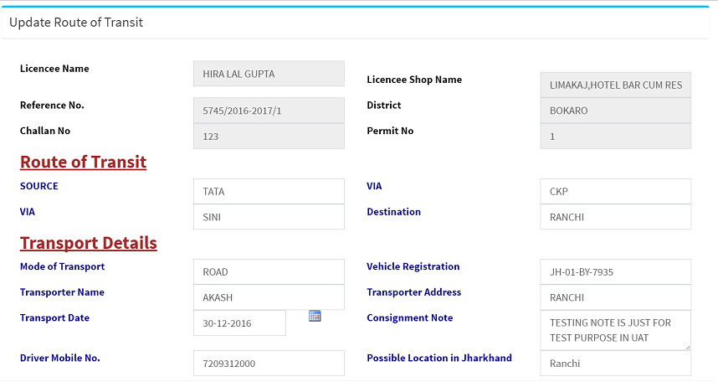
After Approval, Update Route.
Click to Show to open the Form
UPDATE
Click to Update Button after Fill up the Form
Notes:
After Approval by DEO, Retailer Should Update the Route of Transit for Print the Permit.

Slide 6
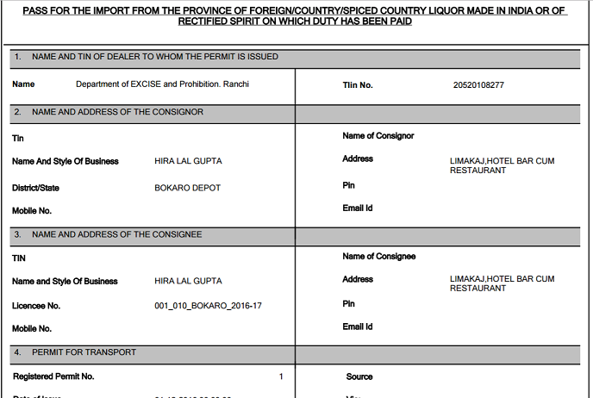
After Route Update, Print Permit.
Click to Show for PERMIT
Notes:
After the Updatation of Route of Transit, Retailer can print / Download the Permit from the Next Tab name ” Permit Issued with Route of Transit ”

Slide 7

THANKING YOU !
Notes:
Thank you.

