Slide 1
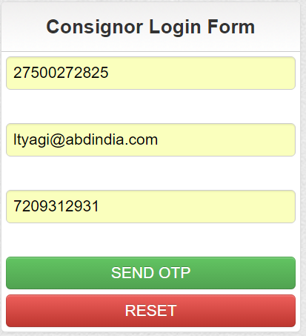
CONSIGNOR LOGIN PAGE
Consignor TIN No.
Consignor Registered Email ID
Consignor Mobile number
Click on SEND OTP
Notes:
State Admin Login Page.

Slide 2
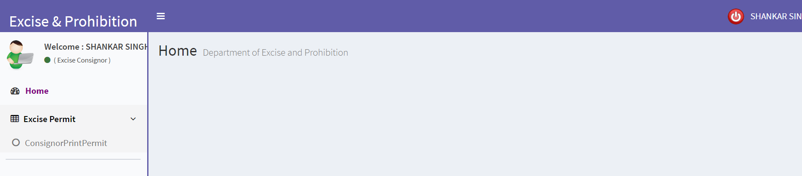
CONSIGNOR DASHBOARD
LOGOUT
This is the menu for Approvals for the Permit of Supplier and Retailer.
Notes:
Consignor Dashboard.

Slide 3
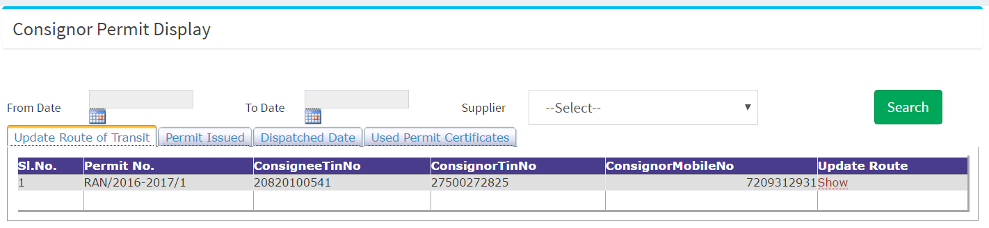
CONSIGNOR PERMIT DISPLAY
Click to Show, to Open the Update Route Form.
Notes:
Consignor Permit Display.

Slide 4
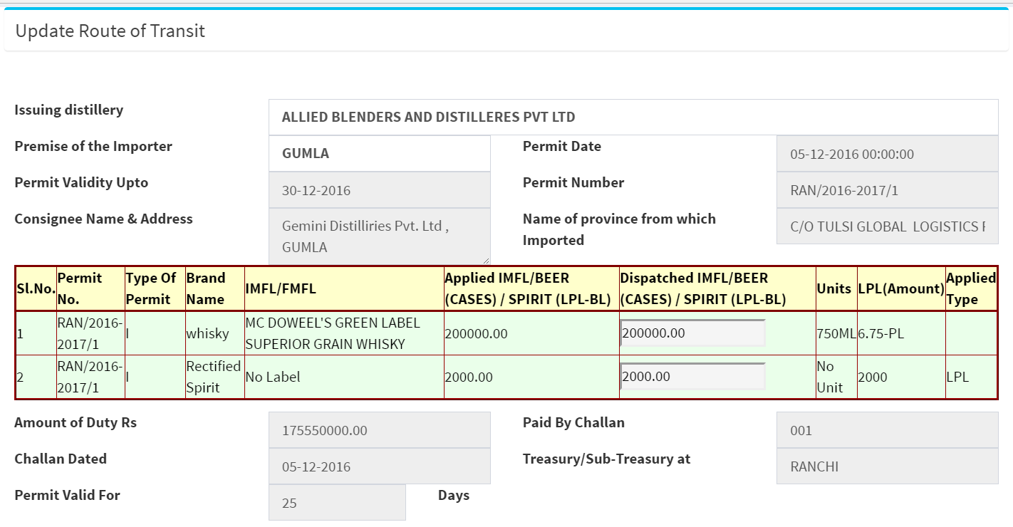
Update Route of Transit
Notes:
Route of transit then Update

Slide 5
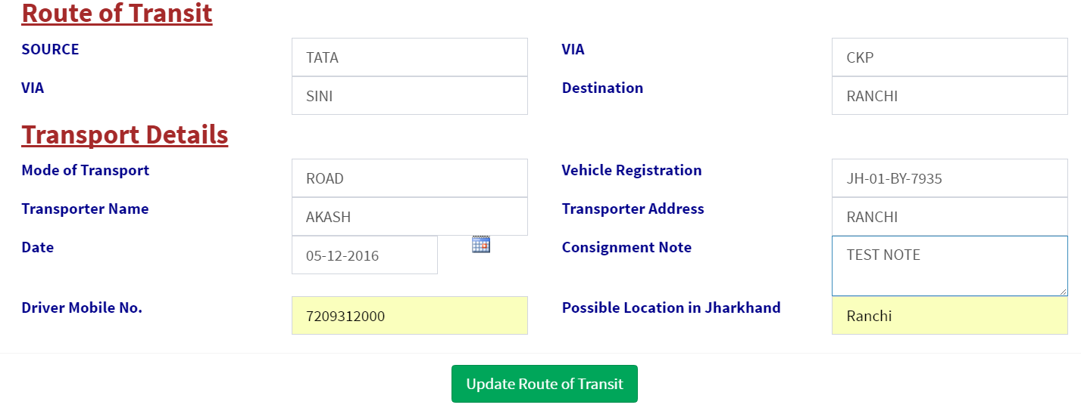
Update Route of Transit
After Fill up all data Click on the Button.
Notes:
Update Route of Transit

Slide 6
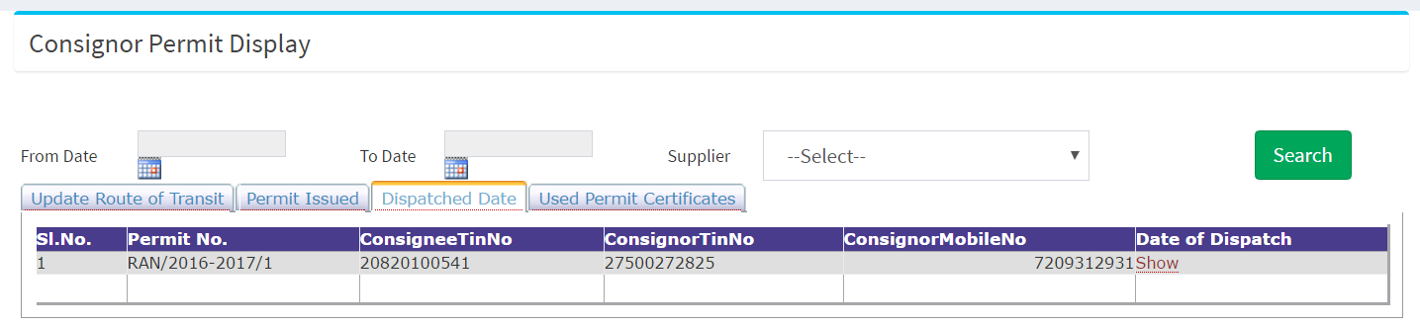
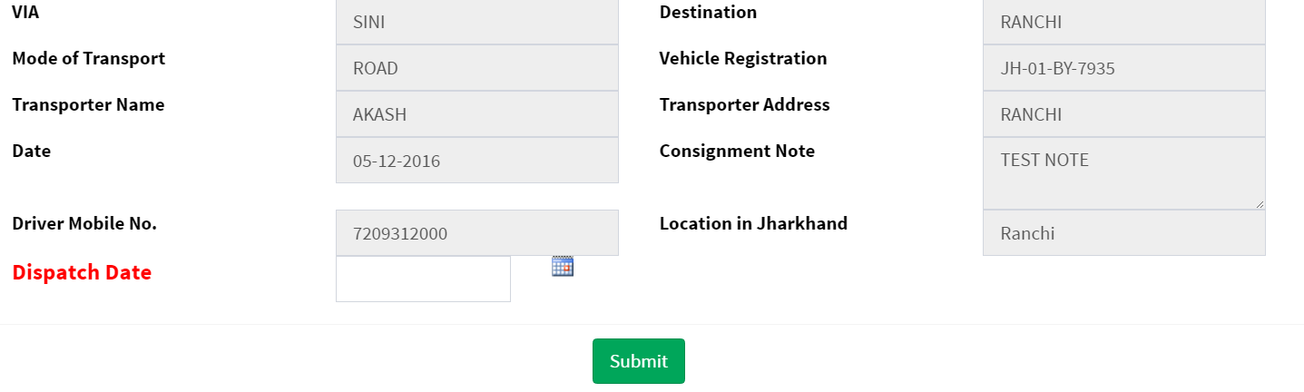
Dispatch Date Entry
Click on Show
Update Dispatch Date
Notes:
Dispatch Date Update by Consignor

Slide 7

THANKING YOU !
Notes:
Thank you.

